Slide 1
Price prediction of used and refurbished devices
ReCell: Supervised Learning Foundations
22 March, 2024

Slide 2
Contents / Agenda
Executive Summary
Business Problem Overview and Solution Approach
EDA Results
Data Preprocessing
Model Performance Summary
Appendix

Slide 3
Executive Summary - Insights
The model is able to explain ~84% of the variation in the data and within 4.5% of the normalized used price in the test data.
If the rear camera resolution increases by one unit, then the normalized price of a used device increases by 0.0209 units, all other variables held constant.
If the front camera resolution increases by one unit, then the normalized price of a used device increases by 0.0138 units, all other variables held constant.
If the RAM of a device increases by one unit, then its price increases by 0.0207 units, all other variables held constant.
If the weight of a device increases by one unit, then its price increases by 0.0017 units, all other variables held constant
If the normalized new price increases by one unit, then the normalized price of a used device increases by 0.4414 units, all other variables held constant.
If the years since release increases by one unit, then the normalized price of a used device decreases by 0.0291 units, all other variables held constant.
The price of 4g compatible devices are 0.0502 units more than non-4g devices
The price of 5g compatible devices are 0.0672 units less than non-5g devices

Slide 4
Executive Summary - Recommendations
Everyone loves a high quality camera to record memorable moments and as the price of a used device increases with its rear and front cameras resolutions, ReCell can focus more on devices with better camera specifications
RAM amount is important for smooth functioning of a device and as the price of a used device increases with its RAM size, devices with larger RAM size can generate more revenue for the company.
As there are lightweight devices with good battery capacity, the company can market those devices to frequent travellers.
Samsung and Huawei are the two most common brands among the used devices indicating high demand for these brands.
The price of used devices has been increasing over the years and with brands releasing new devices yearly, this is an indication of a profitable venture.
Additionally, gathering data like age, occupation etc about their customers would help with targeted marketing of the devices.

Slide 5
Business Problem Overview
Buying and selling used phones and tablets used to be something that happened on a handful of online marketplace sites. But the used and refurbished device market has grown considerably over the past decade, and a new IDC (International Data Corporation) forecast predicts that the used phone market would be worth $52.7bn by 2023 with a compound annual growth rate (CAGR) of 13.6% from 2018 to 2023. This growth can be attributed to an uptick in demand for used phones and tablets that offer considerable savings compared with new models.
The rising potential of this comparatively under-the-radar market fuels the need for an ML-based solution to develop a dynamic pricing strategy for used and refurbished devices
ReCell is a startup aiming to tap the potential in this market of used devices. The task is to analyze the data provided and to build a linear regression model to predict the price of a used phone/tablet and identify the factors that significantly influence it.

Slide 6
Solution Approach
Exploring the data to understand the range of devices sold, device specifications and price
Get an idea about the common brands among used devices
Get an idea about brands that produce devices with certain specifications like large RAM, good camera resolution, good battery capacity, large screen size etc.
Building a linear regression model that can help to predict price of used devices
Checking the model performance and linear regression assumptions

Slide 7
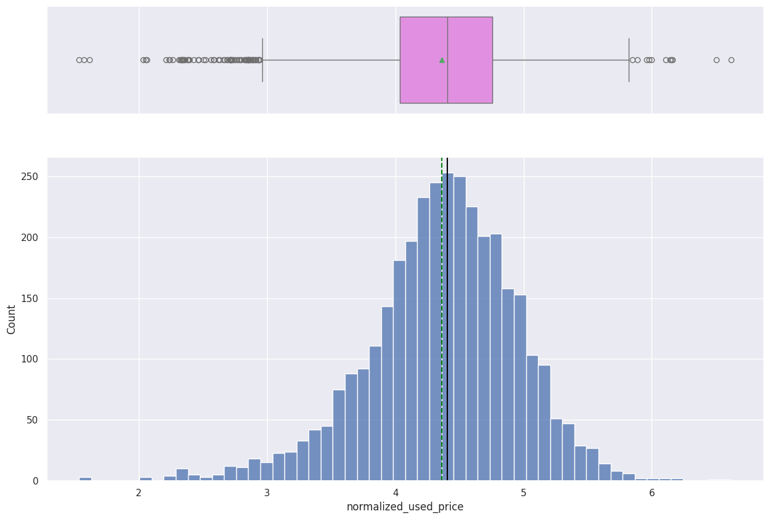
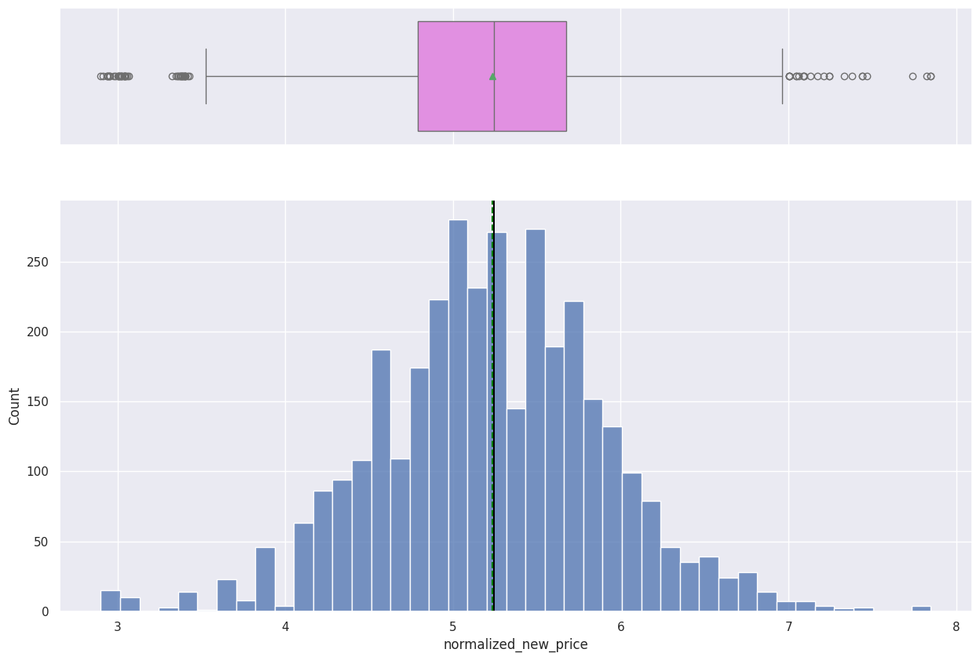
EDA Results - Univariate Analysis
The normalized used price has a slightly left skewed distribution.
Average normalized used price is about 4.4 euros
The normalized new price has a fairly normal distribution.
On average, new devices cost about 5.2 euros.
The outliers present show how varied the devices are, ranging from low-end to high-end devices.

Slide 8
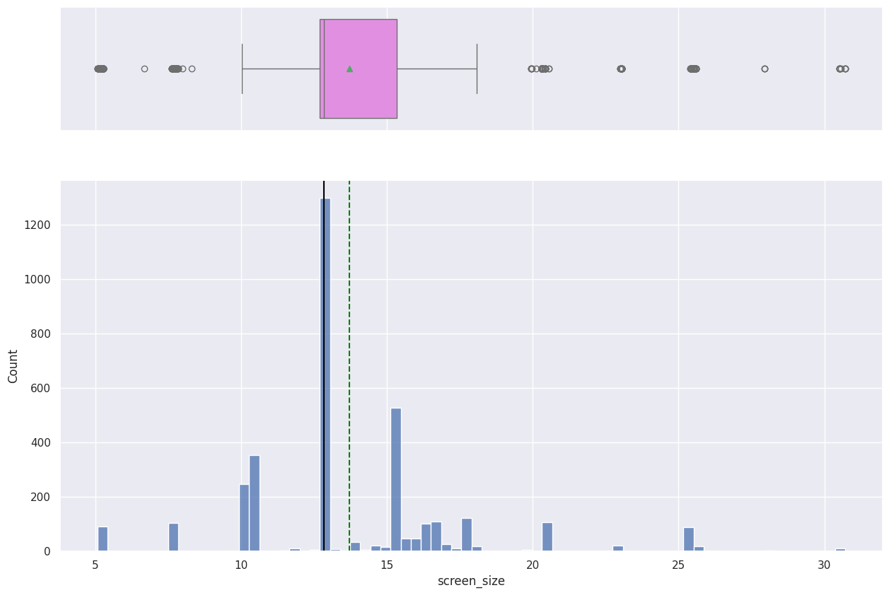
EDA Results - Univariate Analysis
Screen size distribution is right skewed.
A large number of devices have their screen size at about 13 inches

Slide 9
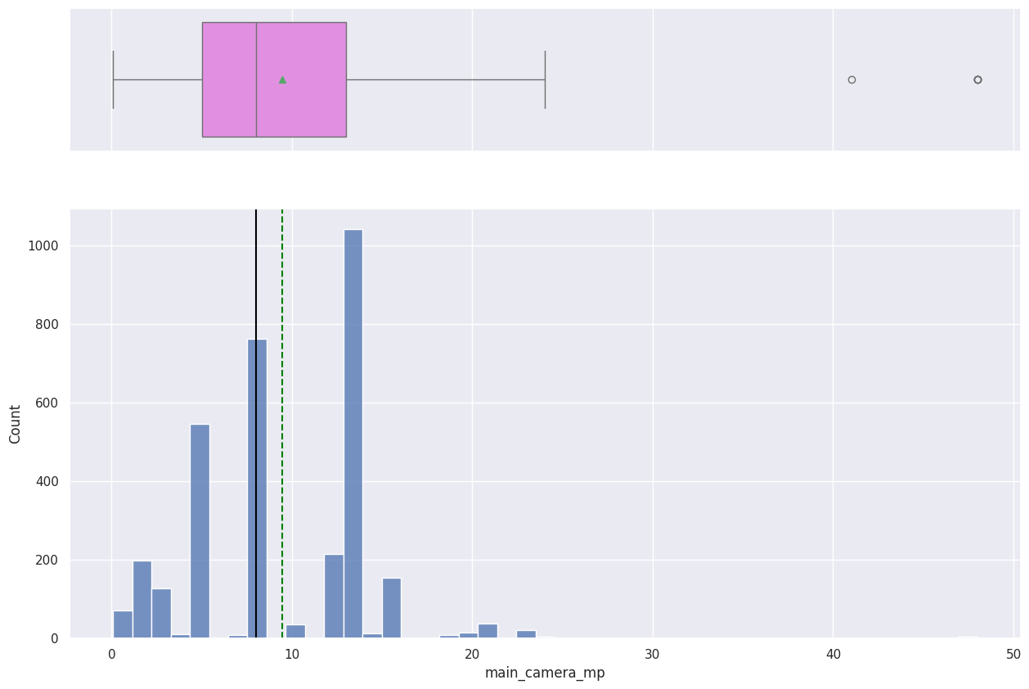
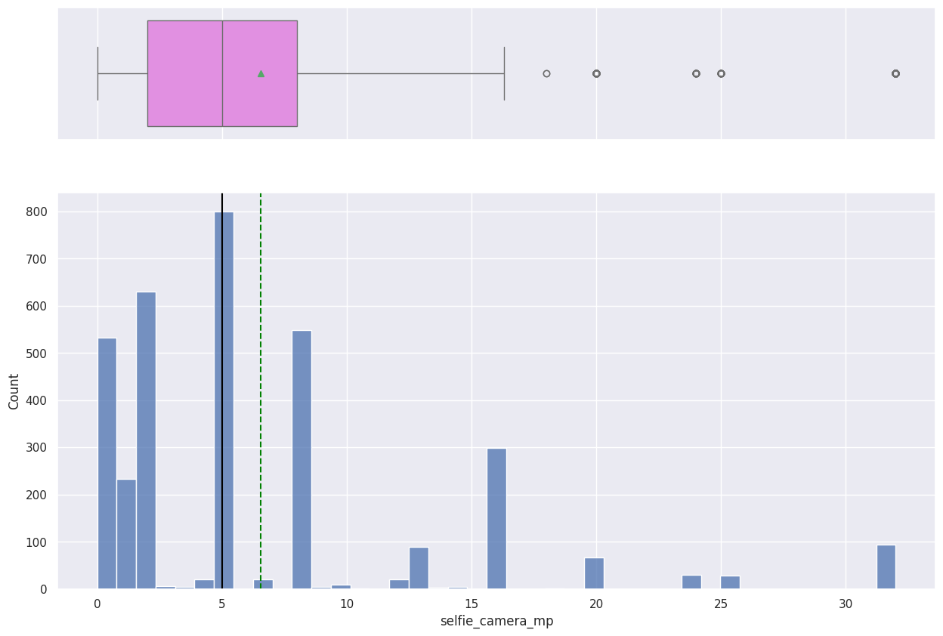
EDA Results - Univariate Analysis
The distribution of the rear camera resolution is right skewed.
Median rear camera resolution is 8 megapixels
The distribution of the front camera resolution is right skewed.
Median front camera resolution is 5 megapixels

Slide 10
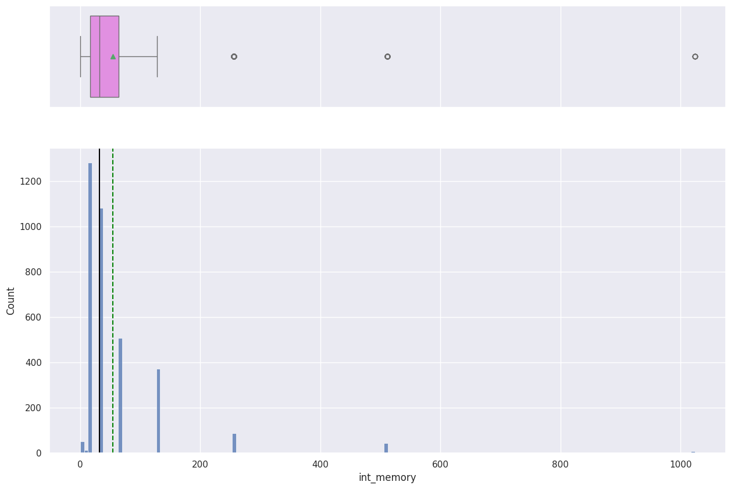
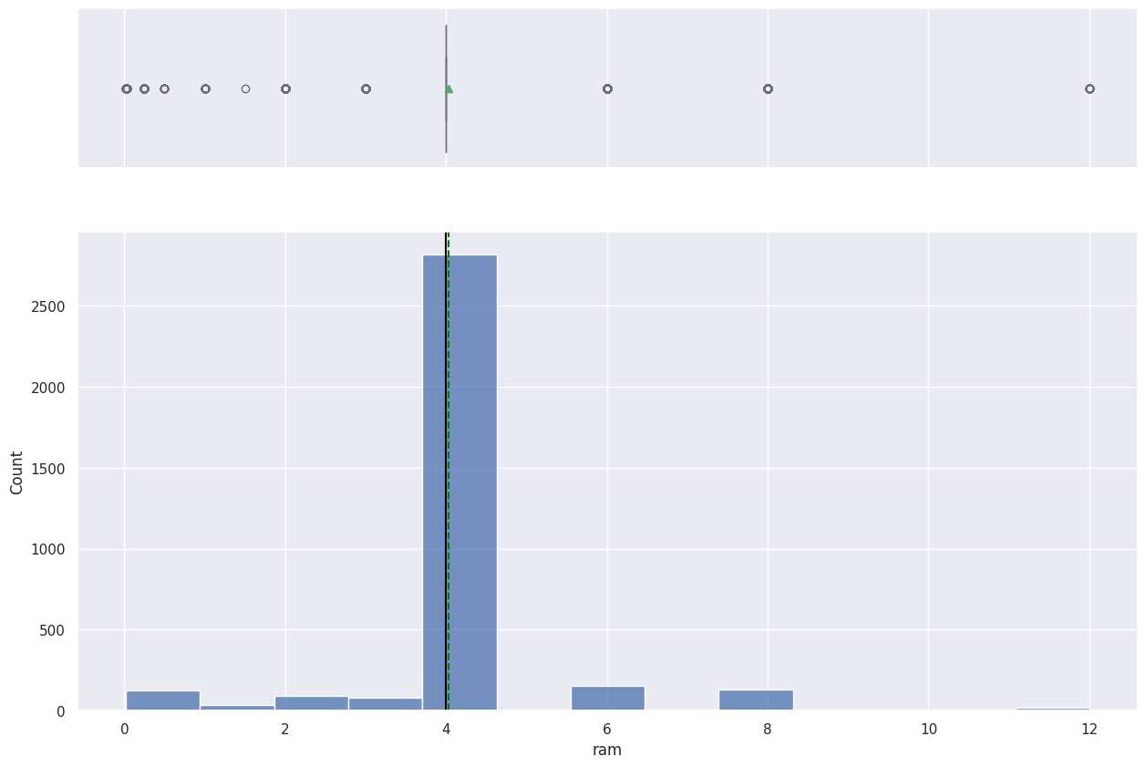
EDA Results - Univariate Analysis
75 % of devices have their internal memory between 0 and 64gb
Largest internal memory in the dataset is 1024gb
A large chunk of devices have 4gb RAM
Largest RAM in the dataset in 12gb

Slide 11
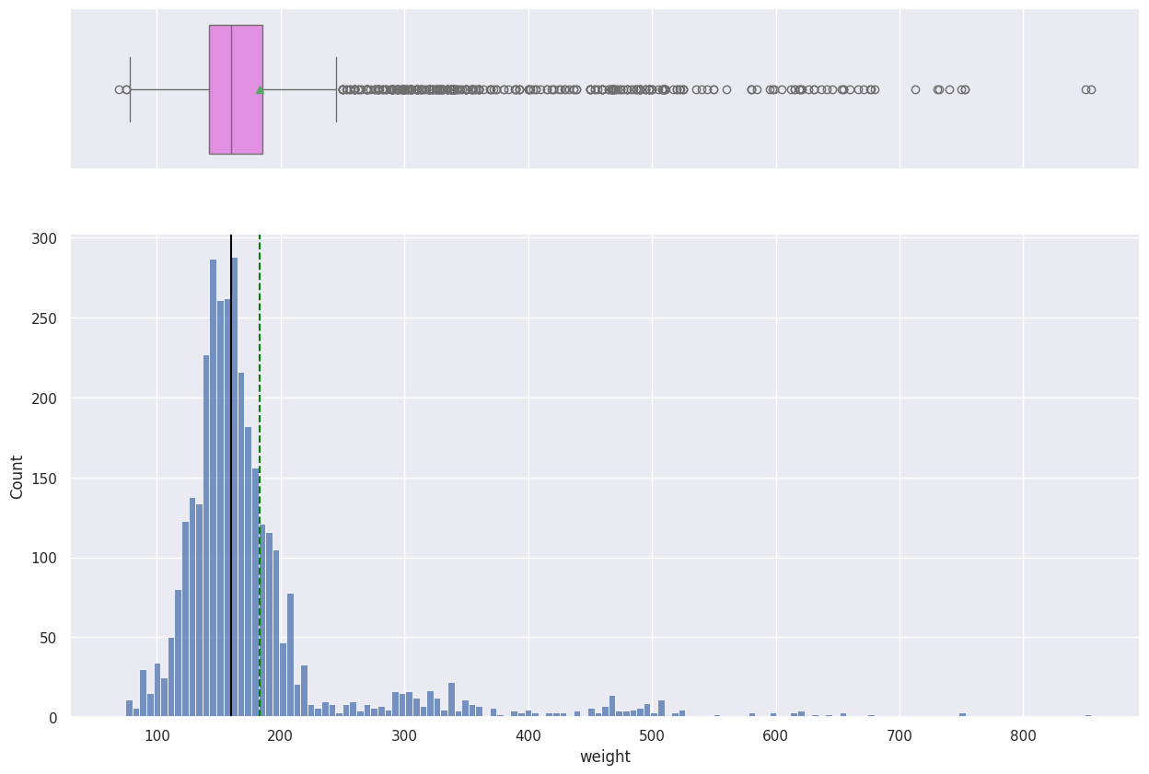
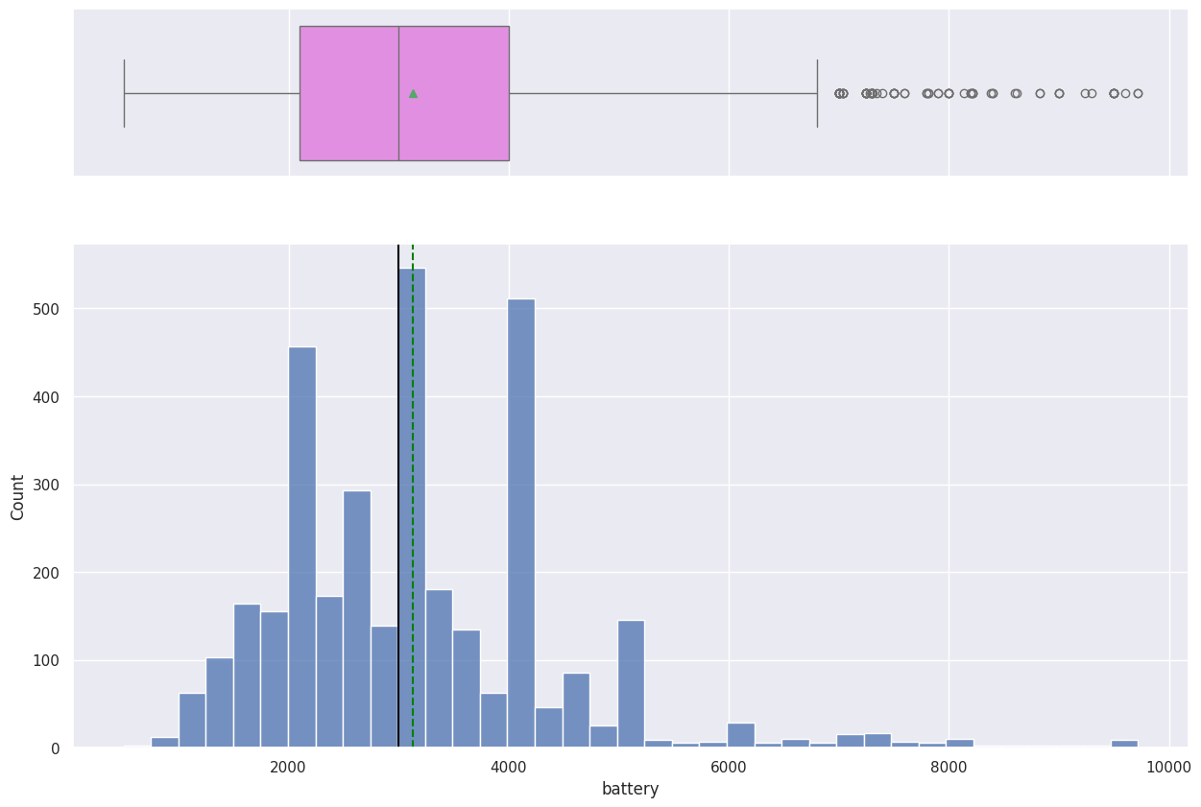
EDA Results - Univariate Analysis
The distribution of the weight of the devices is heavily right skewed. Median weight is about 160g and the heaviest device weighs about 850 which makes sense as tablets are included in the dataset
Distribution of the battery capacity is right skewed. Median battery capacity is 3000 mAh

Slide 12
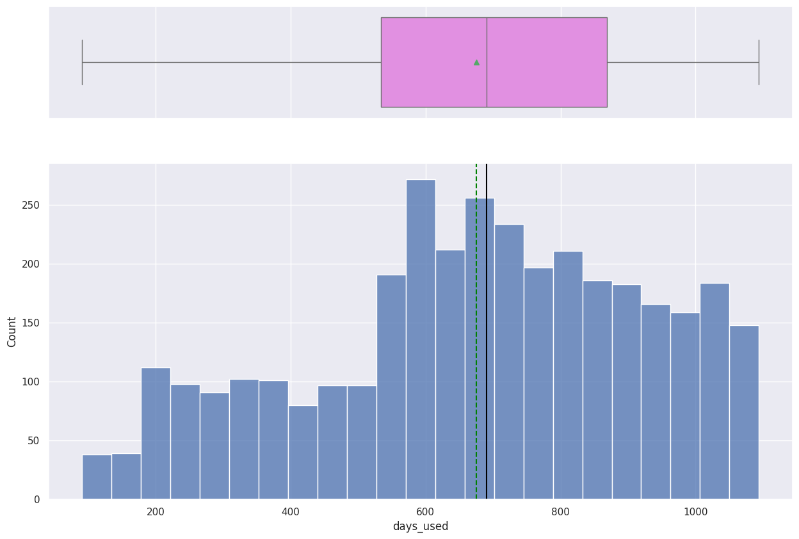
EDA Results - Univariate Analysis
On average, the devices are used for about 670 days

Slide 13
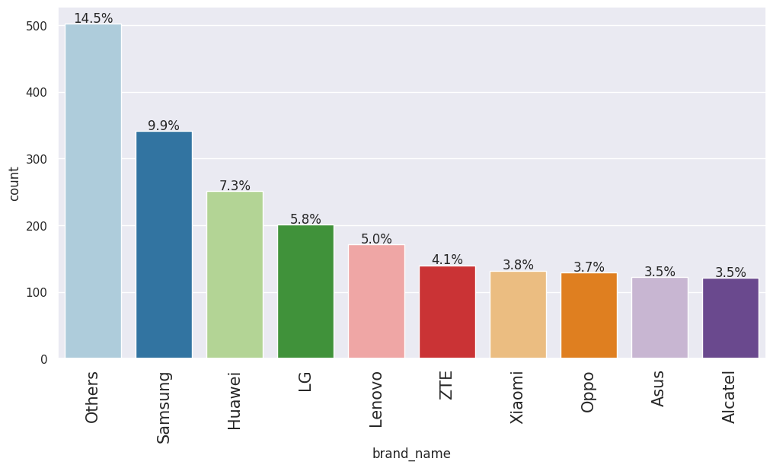
EDA Results - Univariate Analysis
Among the named brands, Samsung is the most common at about 10%

Slide 14
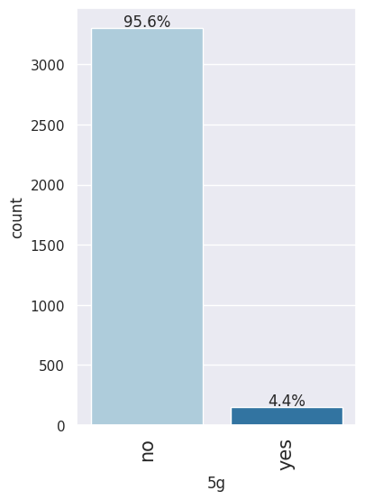
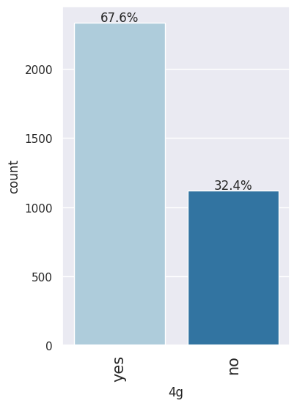
EDA Results - Univariate Analysis
67% of the devices are 4g compatible while 4% are 5g compatible

Slide 15
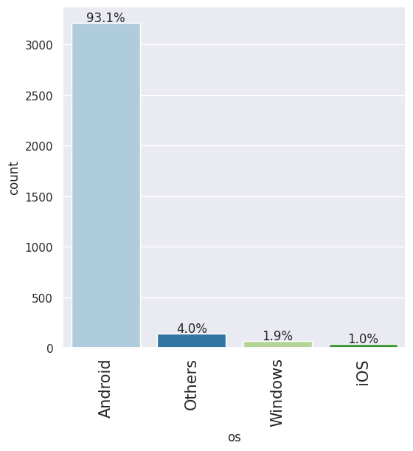
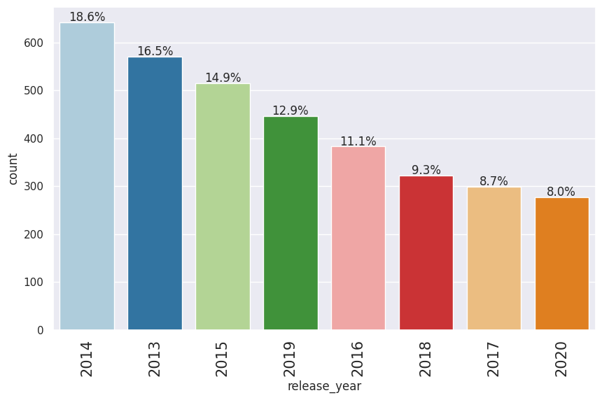
EDA Results - Univariate Analysis
93.1% of the devices have an Android operating system
The largest percentage(18.6%) of the devices were released in 2014

Slide 16
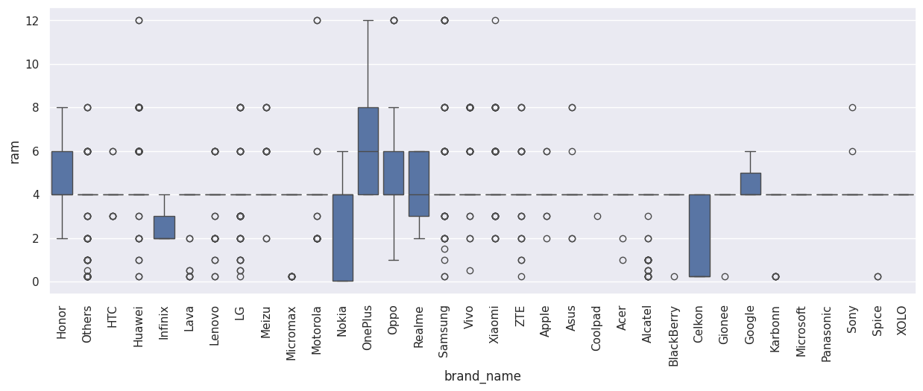
EDA Results - RAM variation across brands
Across most brands, the median RAM is 4gb. Most brands offer devices with RAM as low as 0.02gb.
Huawei, Motorola, OnePlus, Oppo, Samsung and Xiaomi offer devices with RAM as high as 12gb

Slide 17
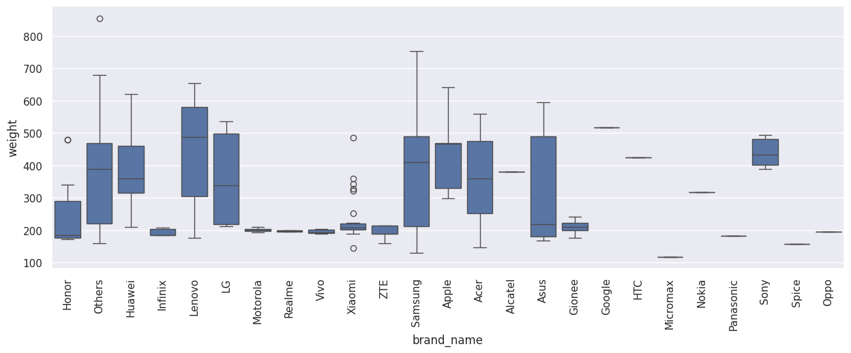
EDA Results - Weight variation across devices with large batteries (>4500mAh)
Among these devices, Weight ranges between ~200 and ~700 grams.
The Brand Micromax has the lightest devices at just over 100g.
There are lots of options in terms of brands with large batteries and relatively low device weight

Slide 18
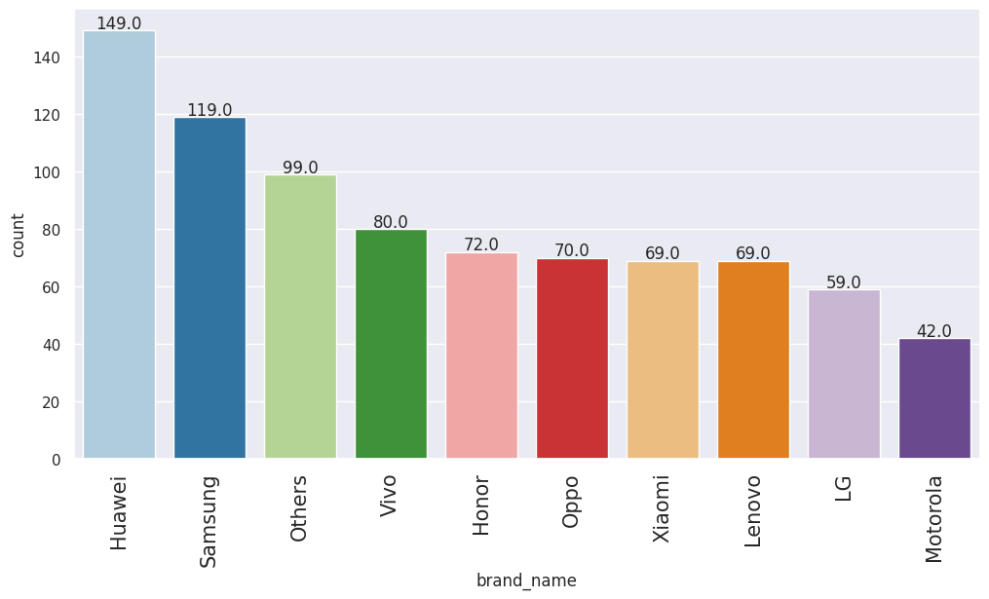
EDA Results - Larger screen size
Huawei has the highest number of devices with large screen size

Slide 19
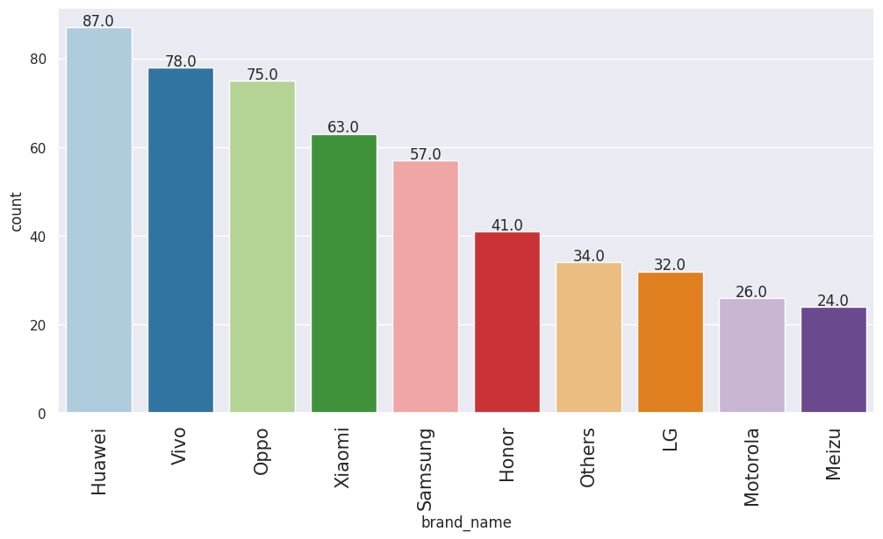
EDA Results - Devices with front cameras with good resolution(>8mp)
Huawei has the highest number of devices with good front camera resolution

Slide 20
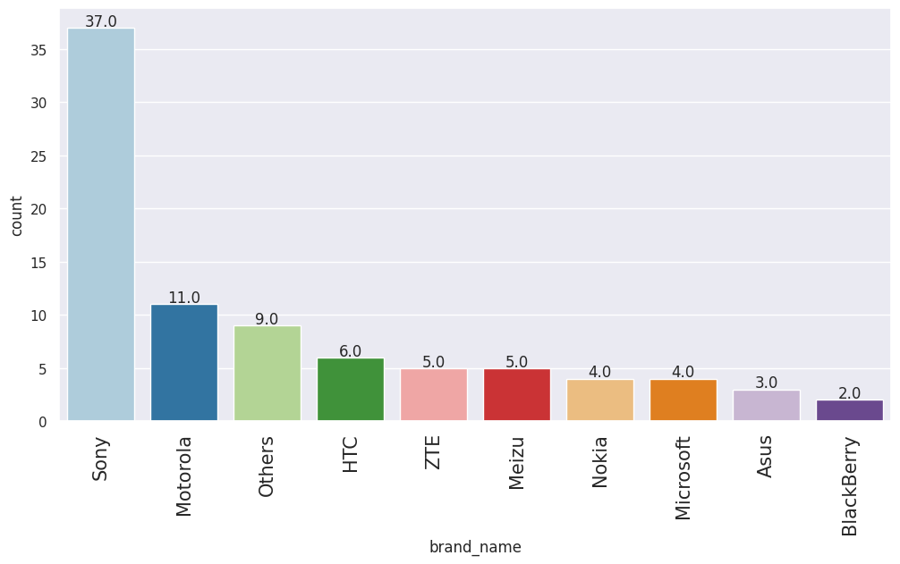
EDA Results - Devices with rear cameras with good resolution (>16mp )
Sony offers the most number of devices with great rear camera resolution

Slide 21
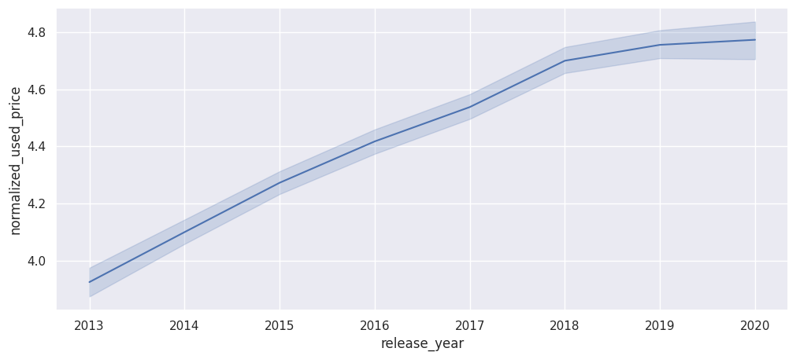
EDA Results - Variation in price of used devices across the years
On average, the price of used phones has increased over the years

Slide 22
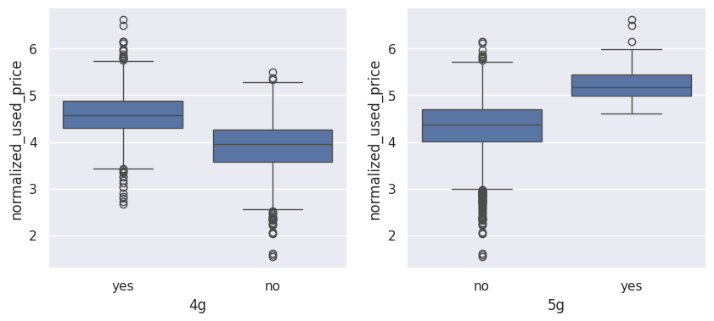
EDA Results - Variation in price of used devices offering 4g and 5g networks
On average, 4g devices are more expensive than non-4g devices and 5g devices are more expensive than non-5g devices

Slide 23
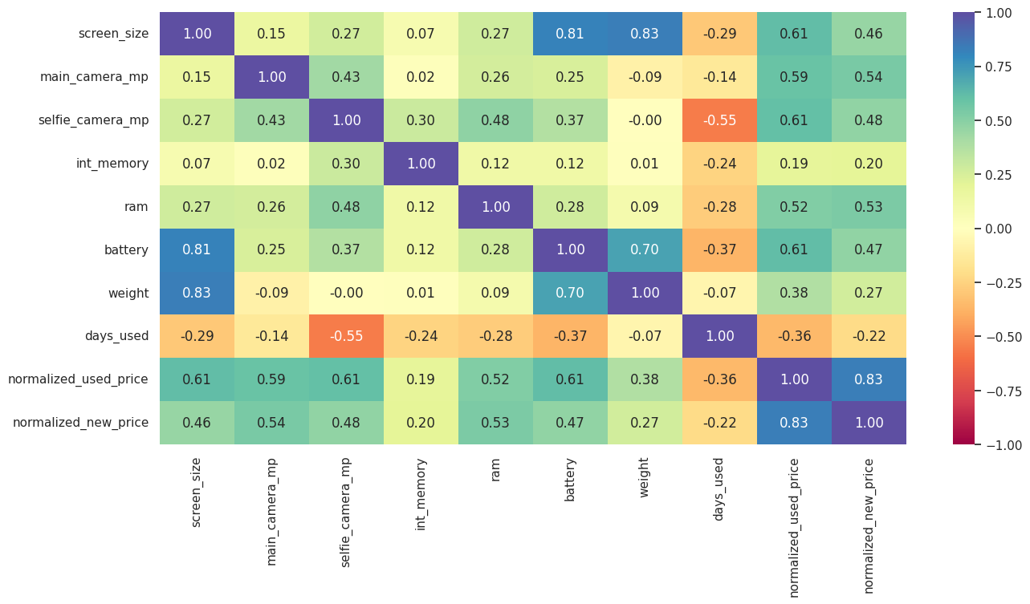
EDA Results - Correlation check
The normalized used price has a high positive correlation with the normalized new price.
Normalized used price is moderately correlated with screen size, rear camera resolution, front camera resolution, RAM and battery capacity
Screen size has a high positive correlation with battery capacity and device weight
Battery capacity has a high positive correlation with device weight

Slide 24
Data Preprocessing
Duplicate value check: There are no duplicate values in the dataset
Missing value treatment: The missing values in the data were first imputed by the columns median grouped by release year and brand name. Then, the remaining missing values after the first step were imputed by the column median grouped by brand name only. Finally, the last of the missing values were filled with the column median.
Outlier check (treatment if needed): The outliers in this data were not treated as they are actual values.
Feature engineering: A new column named years since release was created by taking the difference between the release year and 2021, the year of data collection.
Data preparation for modeling: First, the dependent and independent variables were defined. Categorical variables were encoded by creating dummy variables. The data was then split in 70:30 ratio for the train to test ratio to be able to evaluate the model that was built on the train data.

Slide 25
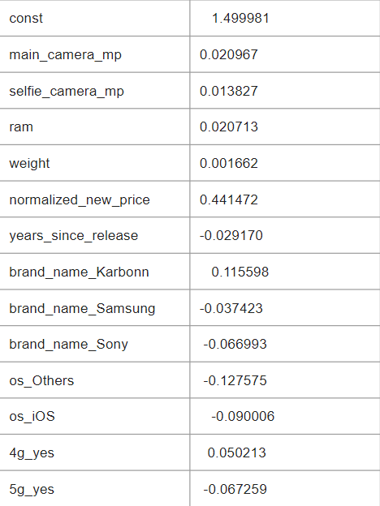
Model Performance Summary
MODEL PARAMETERS
Overview of ML model and its parameters
The model is able to explain ~84% of the variation in
the data and within 4.5% of the normalized used price in
the test data.
Link to Appendix slide on model assumptions

Slide 26
If the rear camera resolution increases by one unit, then the normalized price of a used device increases by 0.0209 units, all other variables held constant.
If the front camera resolution increases by one unit, then the normalized price of a used device increases by 0.0138 units, all other variables held constant.
If the RAM of a device increases by one unit, then its price increases by 0.0207 units, all other variables held constant.
If the weight of a device increases by one unit, then its price increases by 0.0017 units, all other variables held constant
If the normalized new price increases by one unit, then the normalized price of a used device increases by 0.4414 units, all other variables held constant.
If the years since release increases by one unit, then the normalized price of a used device decreases by 0.0291 units, all other variables held constant.
The price of 4g compatible devices are 0.0502 units more than non-4g devices
The price of 5g compatible devices are 0.0672 units less than non-5g devices

Slide 27
Summary of key performance metrics
Training performance
Test performance
The model is able to explain ~84% of the variation in the data
RMSE and MAE for the train and test data are low and comparable so the model is not suffering from overfitting
MAPE suggests the model can predict 4.55% of the price of used devices
RMSE | MAE | R-squared | Adj. R-squared | MAPE
0.23403 | 0.182751 | 0.83924 | 0.838235 | 4.395407
RMSE | MAE | R-squared | Adj. R-squared | MAPE
0.241434 | 0.186649 | 0.838387 | 0.836013 | 4.556349

Slide 28
APPENDIX

Slide 29
Data Background and Contents
The dataset contains 3454 observations and 15 attributes
4 of the attributes are categorical and the rest are numerical
There are some missing values in the dataset
Statistical summary is as follows:
The mean price of used devices is ~4.4
Android operating system is the most common in the dataset
~67% of devices are 4g compatible and ~4% are 5g compatible.
Average number of days of used devices is ~675 days

Slide 30
Model Assumptions - Test for Multicollinearity
Multicollinearity was tested using VIF(Variance inflation factor). Numerical columns with VIF greater than 5 were dropped one by one and the impacts on adjusted R² and RMSE were compared and the variable that made the least change on adjusted R² was dropped.
In this case, the screen size column was dropped.
In addition, predictor variables with p-value greater than 0.05 were dropped as they do not significantly impact the target variable

Slide 31
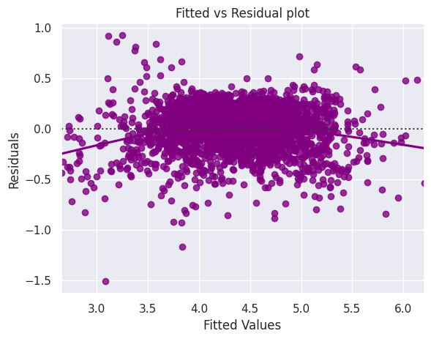
Model Assumptions - Test for Linearity and Independence
Test was done by making a plot of fitted values vs residuals and checking for patterns.
As seen on the plot, there is no pattern therefore, the model is linear and the residuals are independent

Slide 32
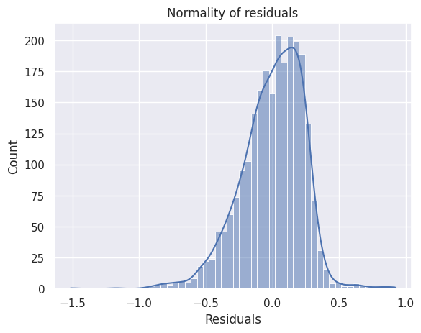
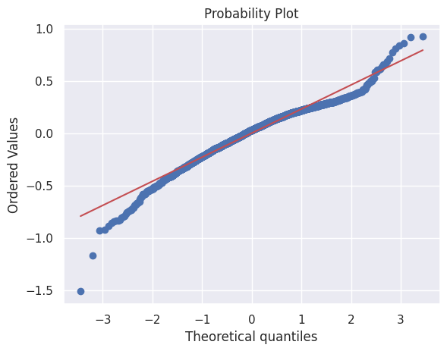
Model Assumptions - Test for Normality
Test for normality was done by checking the distribution of residuals, the Q-Q plot of residuals are by using the Shapiro-Wilk test.
The distribution of the residuals is close to normal, the Q-Q plot of the residuals mostly follows a straight line. However as per the Shapiro-Wilk test, the p-value is >0.05. Strictly speaking, this indicates the residuals are not normal. As an approximation, we can accept this distribution as close to normal

Slide 33
Model Assumptions - Test for Homoscedasticity
Homoscedasticity was tested using the goldfeld quandt test. The p-value obtained from this test was greater than 0.05, hence the residuals are homoscedastic.
In conclusion, all the assumptions were followed.

